Slide 1


A Measurable Ranking of Pre-trained 3D Models: from Least to Most Powerful
Yujie Chen
2024.5.9
Notes:
Hello everyone, Good morning. My name is Chen Yujie, and I am a Master’s student in Computer Science at Peking University and also a summer intern at Johns Hopkins University. I am very pleased to have the opportunity to introduce to you our summer project: "A Measurable Ranking of Pre-trained 3D Models: From Least to Most Powerful."

Slide 2
Background
Lack of labeled data, transfer learning has become a very popular method.
But not all pretrained checkpoints perform well on downstream tasks
Notes:
In the field of image segmentation, due to the lack of labeled data, transfer learning has become a very popular method. It efficiently utilizes limited data on downstream tasks and achieves high dice and nsd scores. However, studies have shown that not all pretrained checkpoints perform well on downstream tasks [ 24 ].

Slide 3
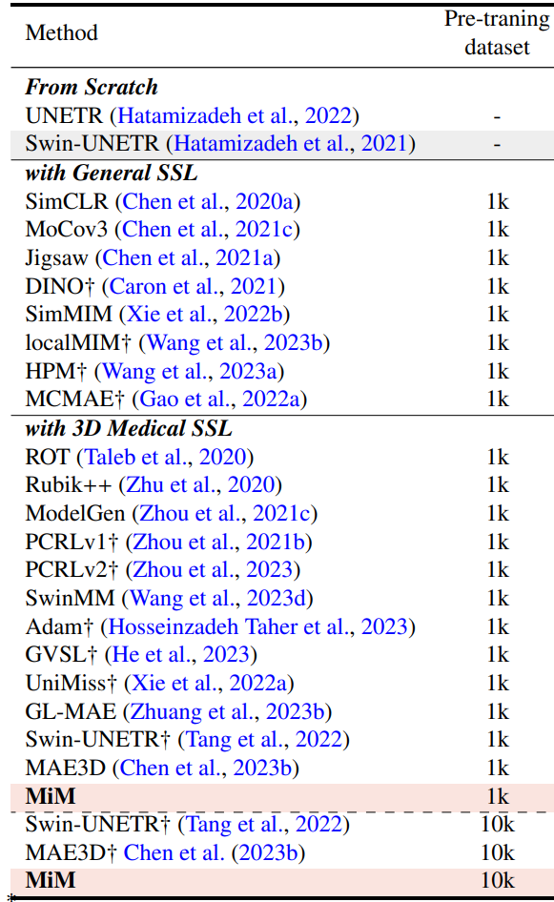
Background
it requires a significant amount of time and computational resources to select the appropriate model and pre-trained weights.
How to rank checkpoints and why?
Figure 1: When you need to complete a 3D image segmentation task, there are many available checkpoints.
Notes:
When you need to choose a model to complete downstream 3D image segmentation tasks, as shown here, there are more than 20 options available, including UNETR, Swin-UNETR, and others. The traditional approach involves using fine-tuning, which means adjusting these models on the target dataset. However, this can consume a significant amount of time and computational resources.
We want to quickly rank the performance of checkpoints on a target task without using fine-tuning in the field of 3D image segmentation, and explore why some checkpoints perform well and why others perform poorly.

Slide 4
Background
2 methods to assess the performance of checkpoints
Linear classifier
Fine-tuning
Notes:
here are two methods to assess the performance of pretrained checkpoints on downstream tasks, i.e., model transferability. The first method is a linear classifier, but it cannot be used for image segmentation tasks. The second method is fine-tuning, which is the gold standard but is inefficient due to its substantial computational resource consumption

Slide 5
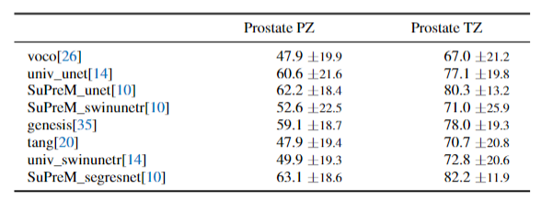
Background - Completed Work 1
We have done some experiments to test transferability of models
generic training script
Table 1: Detailed results of different backbones on MSD. The performance is measured by the DICE score (%).
Notes:
We have done some experiments to test transferability of models. As shown in the table, we used our generic training script to load four checkpoints on the MSD prostate dataset for 5-fold cross validation. The results in the table are the average scores from the 5-fold cross validation. Since the generic training script already includes the mainstream backbones, there is no need to modify the training script when loading most checkpoints.

Slide 6
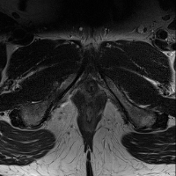
Background - Completed Work 2
We use the prediction results on the MSD prostate test dataset to create videos.
Figure 2: predictions include prostate PZ and prostate TZ regions using SuPreM (unet) on the MSD prostate test dataset
Notes:
In the field of image segmentation, due to the lack of labeled data, transfer learning has become a very popular method. It efficiently utilizes limited data on downstream tasks and achieves high dice and nsd scores. However, studies have shown that not all pretrained checkpoints perform well on downstream tasks [ 24 ].

Slide 7
Background - Completed Work 3
Broadly research the existing methods for evaluating model transferability.
LEEP
N LEEP
LogME
B-Tuning
DEPARA
……
Figure 3: existing methods for evaluating model transferability.

Slide 8
Background - Completed Work 4
Broadly research the existing models of 3D image segmentation.
CUTS
DoDNet
SuPreM
Genesis
3D Open-vocabulary
Med3D
VoCo
Probabilistic-aware
supervised
self-supervised
weakly-supervised
DAEs
universal model
DINO
UniMiSS
……
……
……
Figure 4: In the field of 3D image segmentation, there are existing supervised models, weakly supervised models, and self-supervised models
Notes:
In the field of image segmentation, due to the lack of labeled data, transfer learning has become a very popular method. It efficiently utilizes limited data on downstream tasks and achieves high dice and nsd scores. However, studies have shown that not all pretrained checkpoints perform well on downstream tasks [ 24 ].

Slide 9
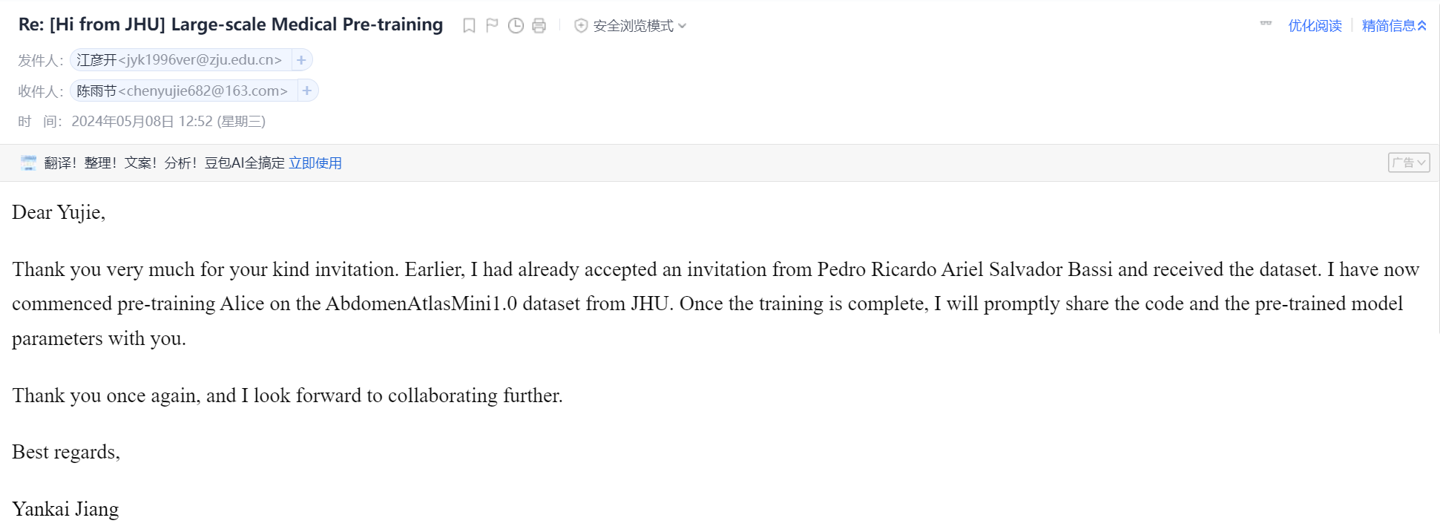
Background - Completed Work 5
Sending emails to the authors of some excellent models to request their pretrained weights.
Figure 5: Alice's author agreed to provide us with the pretrained weights.
Notes:
In the field of image segmentation, due to the lack of labeled data, transfer learning has become a very popular method. It efficiently utilizes limited data on downstream tasks and achieves high dice and nsd scores. However, studies have shown that not all pretrained checkpoints perform well on downstream tasks [ 24 ].

Slide 10
Research Content
Main contribute: A fast method to rank transferability
Argument 1: transfer learning from organs to tumors
Argument 2: transfer learning from coarse (aorta) transferring to fine (sub-classes in aorta).
Argument 3: the quality of labels affects the ability of transfer learning
Notes:
In the field of image segmentation, due to the lack of labeled data, transfer learning has become a very popular method. It efficiently utilizes limited data on downstream tasks and achieves high dice and nsd scores. However, studies have shown that not all pretrained checkpoints perform well on downstream tasks [ 24 ].

Slide 11
Research Method
A fast method to rank transferability
Evaluate the model’s image restoration capability
Extract certain features from the model’s checkpoint weights
Notes:
In the field of image segmentation, due to the lack of labeled data, transfer learning has become a very popular method. It efficiently utilizes limited data on downstream tasks and achieves high dice and nsd scores. However, studies have shown that not all pretrained checkpoints perform well on downstream tasks [ 24 ].

Slide 12
Thank you!

